Slide 1

WCC RETIREEs UMR OPEN ENROLLMENT & NYSHIP Option Transfer Period PLAN YEAR 2026

Slide 2
Agenda
TIPS & TAKEAWAYS
UMR ENROLLEES
NYSHIP ENROLLEES
PLAN RATES
HOW TO CHANGE YOUR HEALTH BENEFIT ELECTION

Slide 3
IMPORTANT
For UMR Enrollees:
Annual Open Enrollment is from December 1, 2025 – December 31, 2025. This is a PASSIVE enrollment for those UMR enrollees. Which means you do not have to submit any forms unless you are making a change to your current plan elections. If you do wish to make changes, i.e., switch plans, add/remove dependents, etc., such changes will be effective January 1, 2026.
For NYSHIP Enrollees:
NYSHIP is having its Option Transfer Period (OTP) from December 01 – December 31, 2025. During the OTP, you may make the following changes:
Change your health plan.
Change from Family to Individual coverage (regardless of whether a qualifying event has affected your dependents’ eligibility).
Change from Individual to Family coverage (late enrollment provisions will apply)
Voluntarily cancel your coverage (regardless of whether a qualifying event has affected your eligibility)
Enroll in NYSHIP coverage (late enrollment provisions will apply)
If you do not want to make any changes to your health plan, no action is required. If you do want to make a change, there are two ways to submit your request:
Option 1: Complete the Health Insurance Transaction Form (PS-404r) and submit it to Employee Benefits Division (EBD):
New York State Department of Civil Service
Employee Benefits Division
Program Administration Unit
Albany, NY 12239
Option 2: MyNYSHIP Online:
MyNYSHIP is a new secure website where retirees can get online access to their own health insurance record.

Slide 4
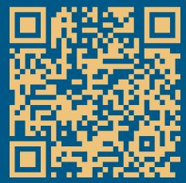
OPEN ENROLLMENT FAST FACTS
Online Access To Enroll / Make changes via our online system HR Benefits (sunywcc.edu)
Open Enrollment Deadline for ALL Plans is December 31, 2025, 11:59 pm
Changes Are Effective January 1, 2026

Slide 5
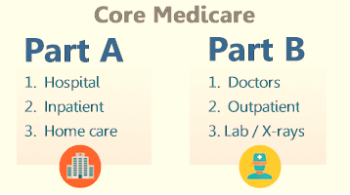
TURNING 65 IN 2026?
If you are turning 65 and are eligible for Medicare, please call Social Security at 800-772-1213 or visit www.socialsecurity.gov three months prior to your birthday month to enroll in Part A & B. When you receive your card Fax a copy to 914-606-7838, or upload a scanned image via our online system HR Benefits (sunywcc.edu) to have your coverage updated.

Slide 6



Important Terms to Know
Coinsurance
Deductible
The dollar amount an enrollee is required to pay before health plan benefits begin to reimburse for services.
The enrollee’s share of the cost of covered services, which is a fixed percentage of covered medical expenses.
Copayment
The enrollee’s share of the cost of covered services, which is a fixed dollar amount paid when a medical service is received, regardless of the total charge for the service.
Out-of-Pocket Limit
The amount you pay for network services/supplies is capped at the out-of-pocket limit. Once the out-of-pocket limit is reached, network benefits are paid in full.

Slide 7

Open Enrollment
To help you with you plan election decision, please use the following Documents on the Retiree Website.
Westchester Community College Health Plan/UMR Summary of Benefits and Coverage.
Westchester Community College Benefit Enrollment/Change Form.
NYSHIP Health Insurance Choices 2026
NYSHIP/Empire Plan Summary of Benefits and Coverage
NYSHIP Employee Benefits Division Health Insurance Transaction Form

Slide 8


Option Transfer Period
To help you with you plan election decision, please use the following Documents on the Retiree Website.
NYSHIP Health Insurance Choices 2026
NYSHIP/Empire Plan Summary of Benefits and Coverage
NYSHIP Employee Benefits Division Health Insurance Transaction Form
NYSHIP retirees do not have the option of UMR.

Slide 9
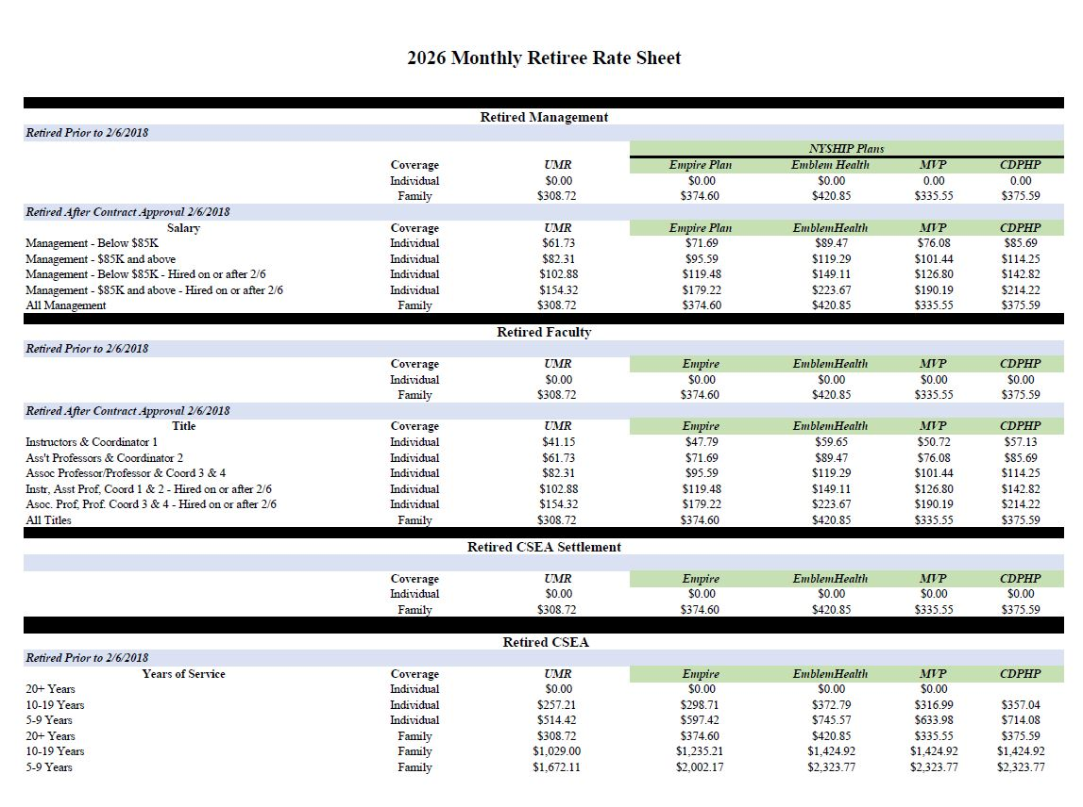
Current Plan rates

Slide 10
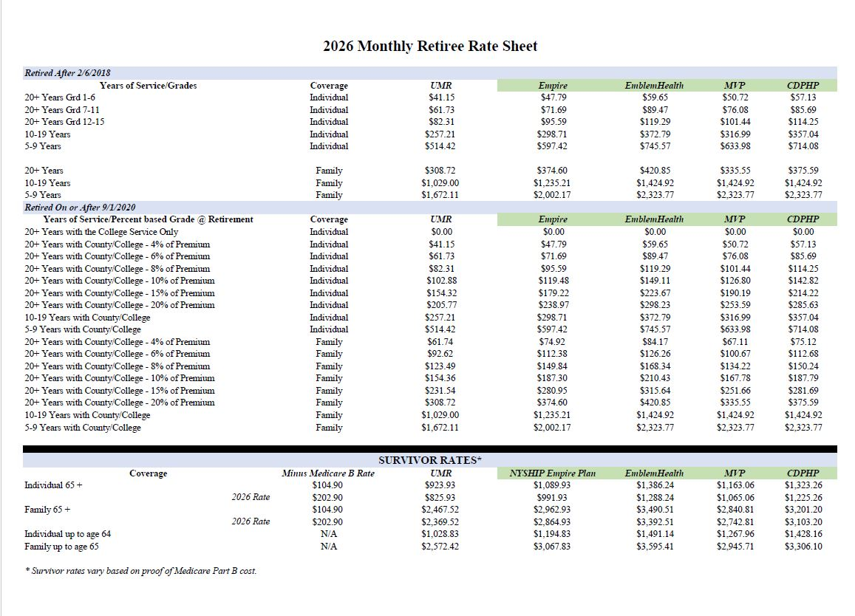
current Plan rates

Slide 11
HOW TO CHANGE YOUR HEALTH BENEFIT ELECTION
The applicable enrollment form (UMR or NYSHIP) must be completed and returned to Benefits, in the Human Resources Department, 75 Grasslands Road, Admin. Building, Room B-42, Valhalla, NY 10595. Forms should be postmarked, emailed (BenefitsInfo@sunywcc.edu), or uploaded via our online system https://wccforms.sunywcc.edu/pages/HR_Benefits.html no later than Wednesday, December 31, 2025.
Please be sure to indicate the level of coverage you are choosing, i.e., individual or family, on the applicable enrollment form. Complete the employee portion of the form and the spouse and dependent section if are requesting family coverage. For dependent coverage, you are required to submit supporting dependent document, such as, marriage certificate, domestic partner documentation, and birth certificates of each dependent.
Please note that once you have made your election, you will not be able to make any changes to your election until the next Open Enrollment, unless you have a Qualifying Event, i.e., marriage, birth of a child, loss of other coverage, divorce, etc. Such events must be reported within 30 days or you will be subject to a waiting period. If you do wish to make a change during the year without a Qualifying Event, then such change will take effect on the 1st of the 3rd month from the date the change was submitted.

Slide 12

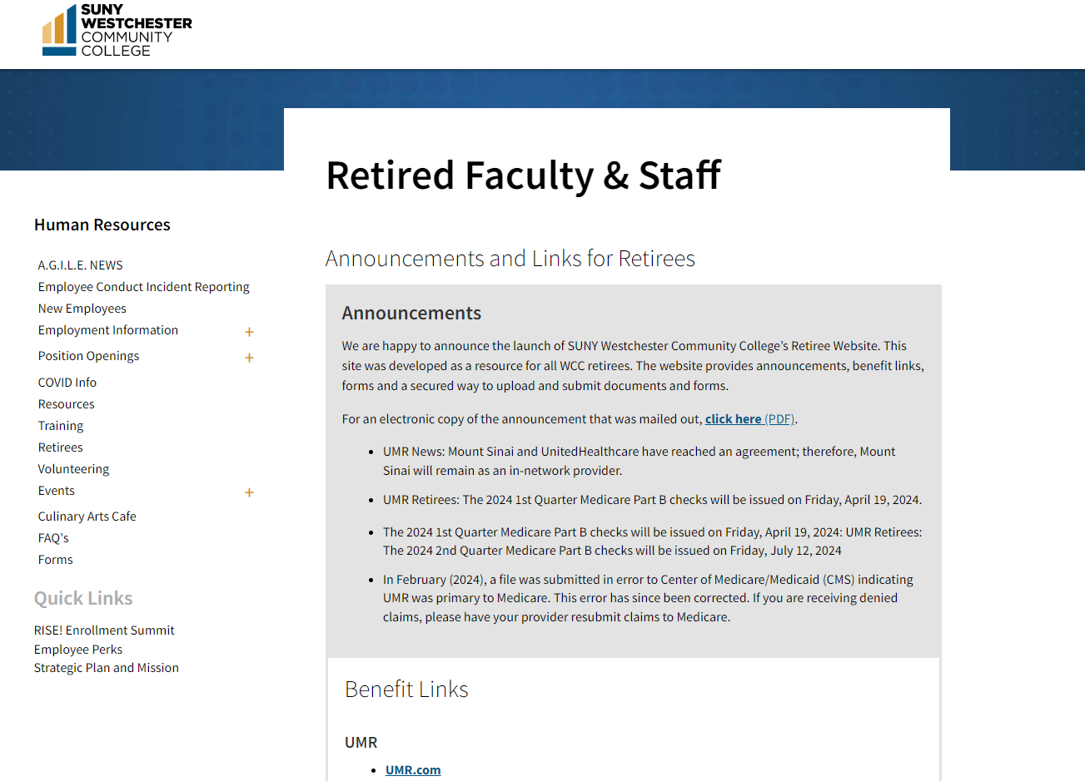


Go online to the RETRIREE BENEFITS page https://www.sunywcc.edu/about/human-resources/retirees/
On the College’s webpage you can learn more about:
Announcements and Links
Plan Comparisons
Open Enrollment Forms
Healthcare Vendors
HR Benefits Secure Link
Benefits Plan Rates

Slide 13
THANK YOU
Cathy Estella-Flashman, SHRM-CP
Benefits Manager | Human Resources
Phone: 914-606-8592
Rich Severi
Program Specialist- Benefits | Human Resources
Phone: 914-606-7818
75 Grasslands Road – Admin Bldg. B42
Valhalla, NY 10595
Fax: 914-606-7838
Email: BenefitsInfo@sunywcc.edu
https://www.sunywcc.edu/about/human-resources/retirees/

